Slide 1
Hackathon Project
Urban Ladder Automation Suite

Slide 2
Team Name Code Crafters
Hackathon Team Information
Team Members
Abhishek Mishra (2403714)
Yash Nemade (2403712)
Tathagata Pal (2403775)
Aashray Gupta (2403713)
Yash Jain (2403725)

Slide 3
Project Overview: Urban Ladder Automation Suite
Project Objective To design and implement maintainable test automation framework for critical
user workflows on the Urban Ladder website, enabling rapid validation of
features through behavior-driven testing and data-driven techniques.
Website Link: https://www.urbanladder.com/

Slide 4
Modules and Features Automated
Feature | Scenario
Add to cart | Add an item to cart and validate its name and price
Auto Suggestions | Validate the working of Auto Suggestion
Being At Home | Retrieve list of items under Being at home
BookShelves | Validate the working of filters and retrieve items
Cities | Retrieve list of stores cities
Help FAQ | Extract all visible FAQs
Login | Attempt sign-in with invalid and valid credentials
Social Media | Validates the working of social media links
Sofas and Recliners | Get all items under sofas and recliners menu
Track Order | Attempt to track order with invalid order id and capture error message

Slide 5
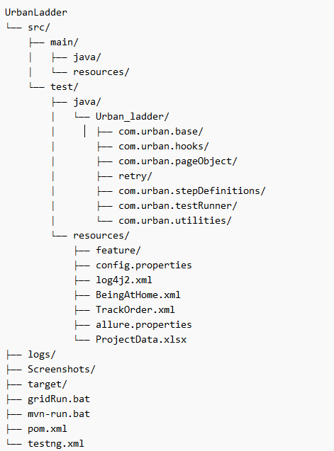
Week 1: Framework Foundation & Feasibility
Goals:
Assess test coverage feasibility
Create framework skeleton
Begin POM and utility module development
Tasks:
Prepare Automation Feasibility Report
Set up Maven/TestNG project with structured directories
Design Page Object Model (POM) using Page Factory

Slide 6
Week 1: Framework Foundation & Feasibility
Build reusable functions for:
Browser actions
Wait mechanisms / Input validations
Define test environment setup via base configuration classes
Deliverables:
Feasibility analysis document
Page classes for Homepage, Bookshelves, Login, Product, etc.
Utility package for reusable interactions

Slide 7
Week 2: Feature Automation & Data-Cucumber Integration
Goals:
Implement feature logic based on requirements
Enable data-driven test coverage
Integrate Cucumber for BDD-style test mapping
Tasks:
Translate Gherkin scenarios into step definitions using Cucumber
Use @Before, @After, and scenario tags for hook-based setup/teardown
Create automation scripts for:
Add to Cart, Auto Suggestions, Sofas and Recliners
Menu retrievals (List of cities, FAQs, categories)
Form validations (Login Page, Track Order)

Slide 8
Week 2: Feature Automation & Data-Cucumber Integration
Implement Excel data integration using Apache POI
Use XML and properties file for configurable runtime inputs and test parameters
Load browser and URL data from .properties files
Deliverables:
Cucumber runner class
Complete step definition coverage
External data files: Excel , Properties, XML

Slide 9
Week 3: Reporting, Execution & Integration
Goals:
Integrate visual and metadata reporting
Ensure stability across supported browsers
Perform regression suite execution and analysis
Tasks:
Implement Allure Reporting:
Integrate with Cucumber step hooks
Attach scenario metadata, results, and screenshots
Generate HTML and JSON summary reports

Slide 10
Week 3: Reporting, Execution & Integration
Configure cross-browser execution:
Validate test scripts on Chrome and Edge
Review handling of headless and headed modes
Conduct regression suite run:
Execute all features with final test data
Review failures and fix tracking
Prepare final report:
Summary of features implemented
Data source coverage
Known issues and recommendations

Slide 11
Project Summary & Learnings
Understood and applied all phases of the Software Testing Life Cycle (STLC) through real-world implementation.
Gained practical knowledge in automation testing using tools like Selenium, TestNG, and Cucumber.
Employed a Page Object Model with reusable functions and Page Factory design for modular test coverage.
Integrated data-driven testing using Excel, XML, and JSON; configurations handled via .properties files.
Implemented rich reporting using Extent and Allure, with screenshots for failures.
Collaborated in an Agile environment using tools like GitHub, with effective version control, branching, and task tracking.
Strengthened teamwork, communication, and automation skills by working collaboratively on a common test suite.

Slide 12
THANK YOU

